Slide 1

MICRO CREDIT LOAN PROJECT
SUBMITTED BY
NIDHI GUPTA
INTERNSHIP 16

Slide 2
INTRODUCTION
In given data we have to predict in terms of a probability for each loan transaction, whether the customer will be paying back the loaned amount within 5 days of issuance of loan. In this case, Label ‘1’ indicates that the loan has been payed i.e. Non- defaulter, while, Label ‘0’ indicates that the loan has not been payed i.e. defaulter.

Slide 3
List of plots
Heat map
Box plot
Pca graph
Strip plot
Histogram
Sub plot

Slide 4
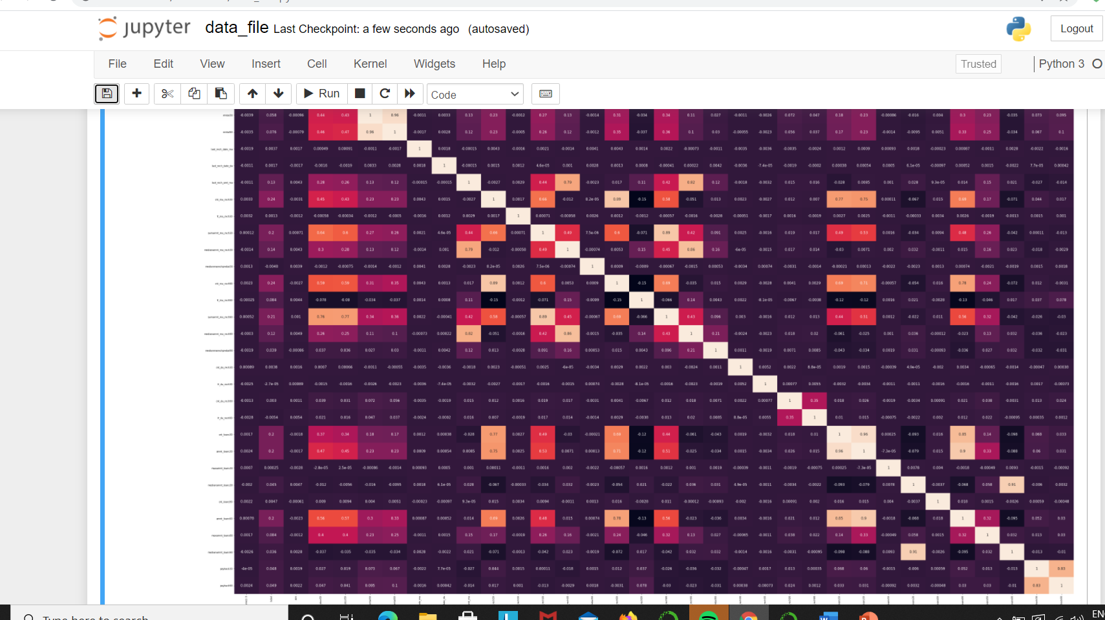
Heat map the diagnol white box line are of non defaulters

Slide 5
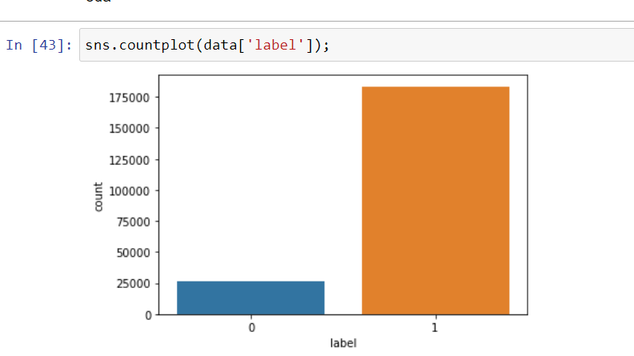
Count plot this shows that more than 175000 count are of non defaulters & less than 50000 are defaulters

Slide 6
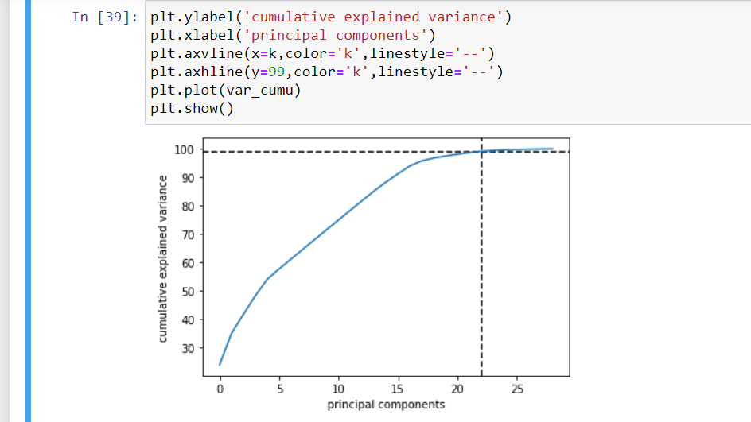
Pca graph

Slide 7
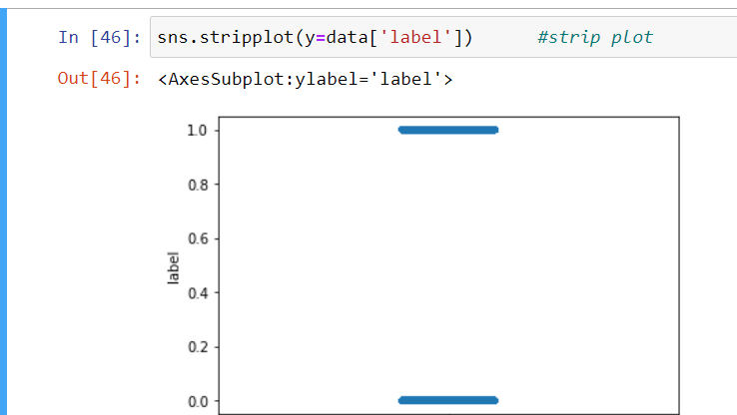
Strip plot

Slide 8
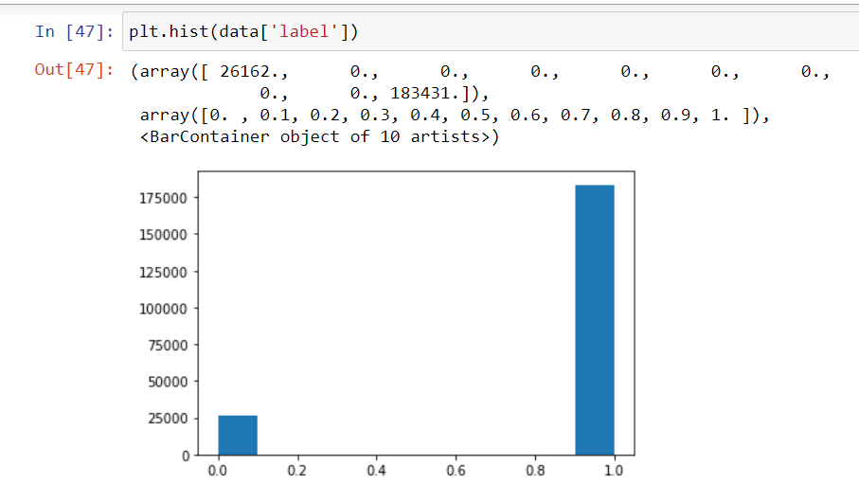
Histogram

Slide 9
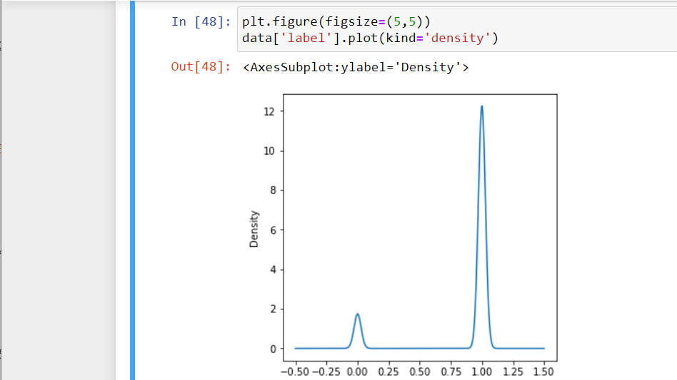
Sub plot

Slide 10
THANK YOU

